Slide 1
Chapter 2: Random Variables
§1 Discrete Random Variables
（离散随机变量）
§2 Continuous Random Variables
（连续随机变量）
§3 Functions of a Random Variable
（随机变量函数）

Slide 2
Chapter 2: Random Variables
§1 Discrete Random Variables
（离散随机变量）
§2 Continuous Random Variables
（连续随机变量）
§3 Functions of a Random Variable
（随机变量函数）

Slide 3
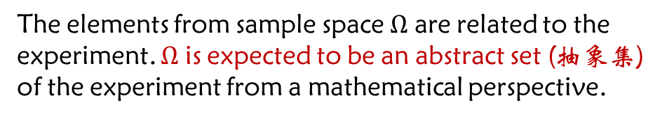
Problems of Classical Probability
Assume that $\left\{Ω,𝒜,P\right\}$ is the probability space for a random experiment E.
Problem A:
The elements from sample space $Ω$ are related to the experiment. $Ω$ is expected to be an abstract set (抽象集) of the experiment from a mathematical perspective.
Problem B:
How to calculate the probability for events of unequal probability (非等可能事件)?
Problem C:
How to apply calculus theory (微积分) to probability theory?
Problem D:
··········

Slide 4










Abstracting the sample space $Ω$
Example:
Toss a coin, the outcome of head or tail is observed. Then
$$Ω=\{H,T\}$$
A sample space with specific implication
Let
$$0, ω=H$$
$$X\left(ω\right)=$$
Called random variable（随机变量）
$$1, ω=T$$
Based on the presentation above, the new “sample space” is
An abstract point set on a line (直线上的抽象点集)
$$\tilde{Ω}=\{0, 1\}$$
The correspondence among the sample points and events:
（相应关系）
$$\{X=0\}$$
$$\{H\}$$
$$\{X=1\}$$
$$\{T\}$$
Notes:
- 随机变量是从$Ω$到实数域上的函数

Slide 5







Example: Toss a coin three times, the sequence of heads and tails are observed.
The sample space is
$$Ω=\{TTT,TTH,THT,HTT,THH,HTH,HHT,HHH\}$$
Define a random variable（随机变量）
$$X=The number of Heads on$$
Then
An abstract point set on a line (直线上的抽象点集)
$$Ω \underset{→}{ X } Ω′=\{0, 1, 2, 3\}$$
Consider the Events which can be expressed by using Random variables:
$$\left\{X=0\right\}=\{TTT\}$$
$$\left\{X=1\right\}=\{TTH,THT,HTT\}$$
$$\left\{X=2\right\}=\{THH,HTH,HHT\}$$
$$\left\{X≤2\right\}=\{TTT,TTH,THT,HTT,THH,HTH,HHT\}$$
$$=\left\{X≤3\right\}−\{X=3\}$$
$$=Ω−\{HHH\}$$

Slide 6
Discrete random variable (离散型随机变量)
Two common types of random variables
Continuous random variable (连续型随机变量)
The result of an experiment is often by itself a random variable:
Example: The number X of hitting the target when a solider shoots n times.
Discrete values
Example: The number N of defective products after randomly picking n products from a big pack.
Example: The daily average temperature X / rainfall Y in a city..
Continuous values
Example: The average life span Y of an electronic device.
Example: The daily power consumption W in a community.
Note:
Usually, we use X, Y, Z, W (upper case) to denote random variables, use x, y, z, w (lower case) to denote their real values (not random).
The abbreviation of “random variable” is r.v.

Slide 7

Discrete random variable (离散型随机变量)
Two common types of random variables
Continuous random variable (连续型随机变量)
Definition: If a r.v. X only takes a finite or almost a countable infinite number of values, then X is called a discrete random variable.
Example: Toss a coin three times, the sequence of heads and tails is observed. Let
$$X=The number of heads on$$
The possible values of X are 0, 1, 2, 3, thus X is a discrete random variable.
Example: Shooting a target without stopping until hitting the target. The number of shots X is a discrete random variable.
Example: The total number of calls that the 114 query service receives in a day is a discrete random variable.
Question:
Is the life span of an electrical device a discrete random variable?

Slide 8

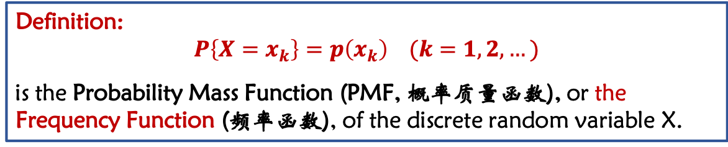
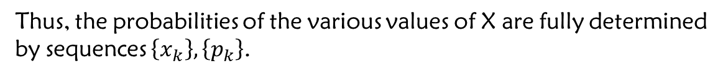
Let X be a discrete r.v. and the possible values of X are
$$x_{1},x_{2},…,x_{k},…$$
and
$$P\left\{X=x_{k}\right\}=p\left(x_{k}\right)=p_{k} (k=1, 2,…)$$
Thus, the probabilities of the various values of X are fully determined by sequences $\left\{x_{k}\right\},\left\{p_{k}\right\}$.
Definition:
$$P\left\{X=x_{k}\right\}=p\left(x_{k}\right) (k=1,2,…)$$
is the Probability Mass Function (PMF, 概率质量函数), or the Frequency Function (频率函数), of the discrete random variable X.
The Frequency Function of a discrete random variable consists of the two important aspects:
①
All possible values of the r.v.
②
The probability of every single value.

Slide 9





Example: Toss a coin three times, the sequence of heads and tails are observed.
$$X=The number of heads on$$
Answer:
The possible values of X are 0, 1, 2, 3. The original sample space is
$$Ω=\{TTT,TTH,THT,HTT,THH,HTH,HHT,HHH\}$$
The Frequency Function of X is
Go through all the sample points
$$P\left\{X=0\right\}=$$
$$\frac{1}{8}$$
$$\frac{3}{8}$$
$$P\left\{X=1\right\}=$$
$$P\left\{X=2\right\}=$$
$$\frac{3}{8}$$
The sum is 1.
$$P\left\{X=3\right\}=$$
$$\frac{1}{8}$$
Question:
What are the properties of Frequency Function?

Slide 10
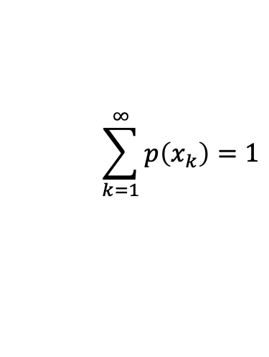


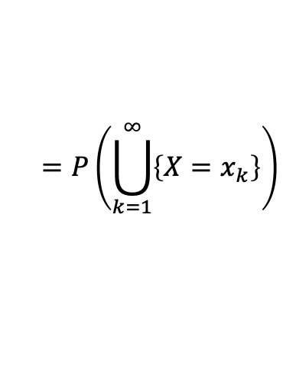
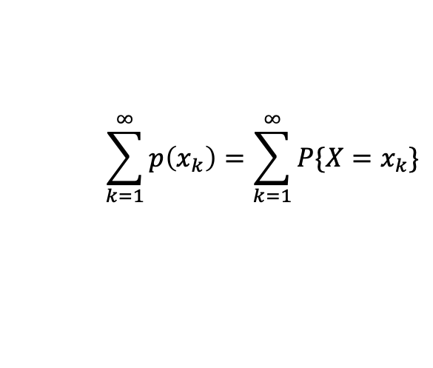
The basic properties of Frequency Function:
①
$$p(x_{k}) ≥0, k=1, 2, …$$
The essential properties of Frequency Function
$$\sum_{k=1}^{∞}{p\left(x_{k}\right)=1}$$
②
$$\sum_{k=1}^{∞}{p\left(x_{k}\right)}=\sum_{k=1}^{∞}{P\{X=x_{k}\}}$$
Proof:
②
$$=P\left(\bigcup_{k=1}^{∞}{\left\{X=x_{k}\right\}}\right)$$
$$=P\left(Ω\right)=1$$
The implications of “essential properties”:
The Frequency Function of a discrete r.v. must satisfy properties 1 and 2.
A sequence $\{p_{k}\}$ satisfying properties 1 and 2 should be the Frequency Function of some discrete r.v.

Slide 11
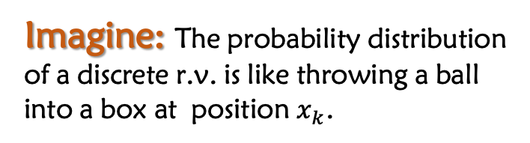
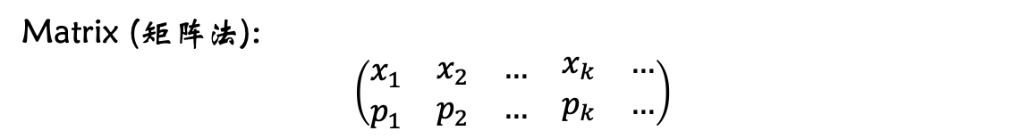
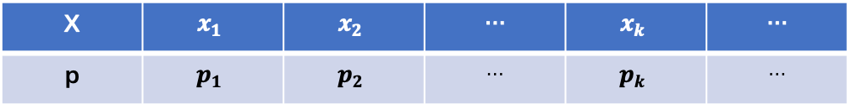


Three Presentations of the Frequency Function
Expression (解析式法):
$$P\left\{X=x_{k}\right\}=p_{k} (k=1,2,…)$$
Table (列表法):
X | $$x_{1}$$ | $$x_{2}$$ | … | $$x_{k}$$ | …
p | $$p_{1}$$ | $$p_{2}$$ | … | $$p_{k}$$ | …
Matrix (矩阵法):
$$\left(\begin{matrix}x_{1} & \begin{matrix}x_{2} & … & \begin{matrix}x_{k} & …\end{matrix}\end{matrix} \\ p_{1} & \begin{matrix}p_{2} & … & \begin{matrix}p_{k} & …\end{matrix}\end{matrix}\end{matrix}\right)$$
Imagine: The probability distribution of a discrete r.v. is like throwing a ball into a box at position $x_{k}$.
The probability of throwing a ball into the kth box is p_{k}
$$x_{k}$$

Slide 12





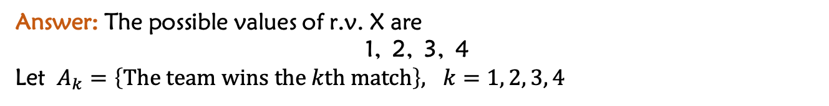

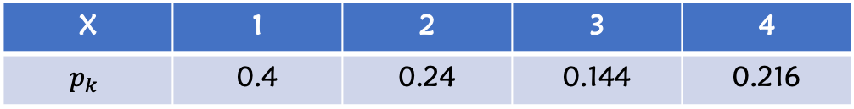




Example: A football team needs to win all 4 matches to be able to win the game. Assume that the probability of the team being eliminated (淘汰) at each match is p=0.4. Let X be the number of matches that the team has played when the game ends. What is the Frequency Function of X?
Answer: The possible values of r.v. X are
1, 2, 3, 4
Let $A_{k}=\left\{The team wins the kth match\right\}, k=1, 2, 3, 4$
Then
$$P\left\{X=1\right\}=P({\overline{A}}_{1})$$
$$=p=0.4$$
$$P\left\{X=2\right\}=P(A_{1}{\overline{A}}_{2})$$
$$=P\left({\overline{A}}_{2} | A_{1}\right)P\left(A_{1}\right)$$
$$=p\left(1−p\right)=0.4∗0.6= 0.24$$
$$P\left\{X=3\right\}=P(A_{1}A_{2}{\overline{A}}_{3})$$
$$=P\left({\overline{A}}_{3} | A_{1}A_{2}\right)P\left(A_{2} | A_{1}\right)P\left(A_{1}\right)$$
$$=p{\left(1−p\right)}^{2}=0.144$$
$$P\left\{X=4\right\}=$$
$$P\left(A_{1}A_{2}A_{3}{\overline{A}}_{4}\right)+P(A_{1}A_{2}A_{3}A_{4})$$
$={p\left(1−p\right)}^{3}+{\left(1−p\right)}^{4}$ $={ \left(1−p\right)}^{3}=0.216$
Then the Frequency Function of r.v. X is
X | 1 | 2 | 3 | 4
$$p_{k}$$ | 0.4 | 0.24 | 0.144 | 0.216

Slide 13
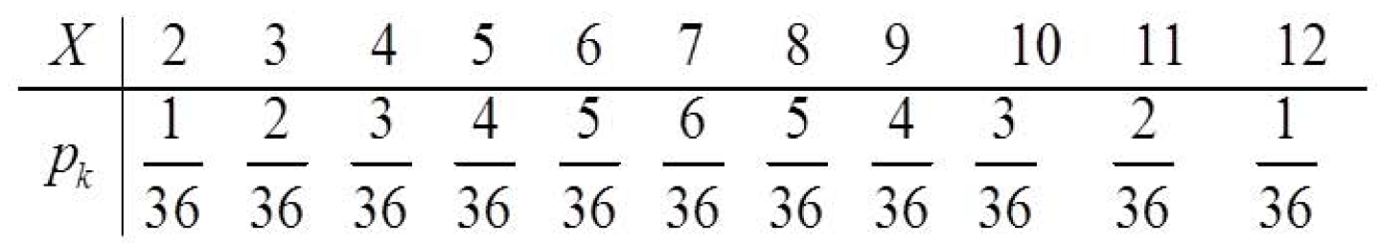
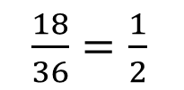
Exercise: Roll two fair dices and observe their numbers on. Let X be the sum of the numbers of the two dices, find：
a) the Frequency Function of X, and then display them on x-y coordinates;
b) the probability of X when they are odd numbers.
Answer: The possible values of r.v. X are
2, 3, 4, 5, 6, 7, 8, 9, 10, 11, 12
How many combinations of the two numbers :
6 * 6 = 36
a)
b)
$\frac{18}{36}=\frac{1}{2}$

Slide 14
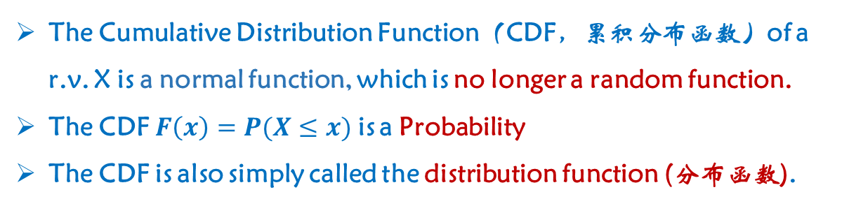
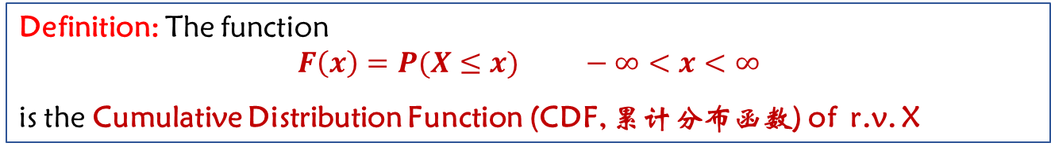


Random variable $X=X(ω)$ is a function of the sample point $ω$. Since it is a “random function”, we cannot apply calculus tools.
Question
How to transform a “random function”（随机函数）to a“normal function”(正常函数）?
For r.v. X, $∀x∈\left(−∞,∞\right)$
$$\left\{X≤x\right\}=\left\{ω | X\left(ω\right)≤x\right\}∈𝒜$$
Event
Definition: The function
$$F\left(x\right)=P(X≤x) −∞<x<∞$$
is the Cumulative Distribution Function (CDF, 累计分布函数) of r.v. X
Note
The Cumulative Distribution Function（CDF，累积分布函数）of a r.v. X is a normal function, which is no longer a random function.
The CDF $F\left(x\right)=P(X≤x)$ is a Probability
The CDF is also simply called the distribution function (分布函数).
Notes:
Take the coin tossing experiment as an example, for $ω=TTT$, $X=0$ ($X$ means the number of heads on), so $X$ can be considered a function of $ω$.
How to interpret “random function”?
因为样本空间$Ω$中试验结果的发生是随机的，所以由此函数定义的取值也是随机的

Slide 15

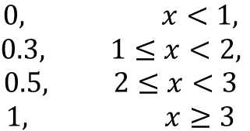
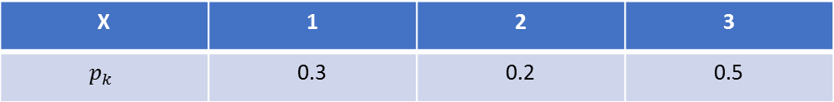






Example: Assume the Frequency Function (频率函数 PMF) of r.v. X is
X | 1 | 2 | 3
$$p_{k}$$ | 0.3 | 0.2 | 0.5
What is the Cumulative Distribution Function (累计分布函数 CDF)?
Answer: Based on the definition of Cumulative Distribution Function
$$∀ x<1, F\left(x\right)=P\left\{X≤x\right\}$$
$$=P\left(Φ\right)=0$$
$$∀ 1≤x<2, F\left(x\right)=P\{X≤x\}$$
$$=P\left\{X=1\right\}=0.3$$
$$∀ 2≤x<3, F\left(x\right)=P\{X≤x\}$$
$$=P\left\{X=1\right\}+P\left\{X=2\right\}=0.5$$
$$∀ x≥3, F\left(x\right)=P\{X≤x\}$$
$$=P\left(Ω\right)=1$$
Question:
$$\begin{matrix}0, x<1, \\ 0.3, 1≤x<2, \\ \begin{matrix}0.5, 2≤x<3 \\ 1, x≥3\end{matrix}\end{matrix}$$
y
What are the special properties of the CDFs?
$$∴F\left(x\right)=$$
1
Since CDFs are normal functions, calculus tools can be applied.
0.5
0.3
0
x
1
2
3

Slide 16





y
The Cumulative Distribution Function of r.v. X
$$F\left(x\right)=P\left\{X≤x\right\}, −∞<x<∞$$
1
0.5
0.3
0
1
2
3
x
The basic properties of Cumulative Distribution Function (累积分布函数 CDF)
①
$F\left(x\right)$ is a monotone non-decreasing function (单调不减函数)
②
$0≤F\left(x\right)≤1$, and
$$F\left(−∞\right)=\lim_{x→−∞}{F\left(x\right)=0},$$
$$F\left(+∞\right)=\lim_{x→+∞}{F\left(x\right)=1}$$
③
$F\left(x\right)$ is a Right Continuous Function (右连续函数), i.e.,
$$F\left(x+0\right)=\lim_{t→x^{+}}{F\left(t\right)=F(x)}$$
Note
The Cumulative Distribution Function of a r.v. must satisfy Properties 1, 2, 3.
A function which satisfies Properties 1, 2, 3 must be the Cumulative Distribution Function of some r.v.

Slide 17








Question:
How to use distribution function（分布函数）to calculate probability（概率）:
$$P\left\{a<X≤b\right\} (a<b)$$
Answer:
$$∵\left\{a<X≤b\right\}=\left\{X≤b\right\}−\{X≤a\}$$
$$\left\{X≤a\right\}⊂\{X≤b\}$$
$$∴P\left\{a<X≤b\right\}=P\left\{X≤b\right\}−P\{X≤a\}$$
$$=F\left(b\right)−F(a)$$
Question: How to calculate the probability $P\{X=c\}(c is constant)$?
Answer:
$$∀∆t>0,\left\{X=c\right\}⊂\{c−∆t<X≤c\}$$
$$∴P\left\{X=c\right\}=\lim_{∆t→0^{+}}{P}\{c−∆t<X≤c\}$$
$$=\lim_{∆t→0^{+}}{[F\left(c\right)−F\left(c−∆t\right)]}$$
$$=F\left(c\right)−F(c−0)$$
If F(x) is continuous at x=c,
then P{x=c}=0.
If it is discrete, P{x=c} = 0

Slide 18
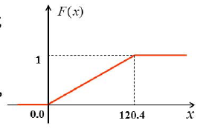
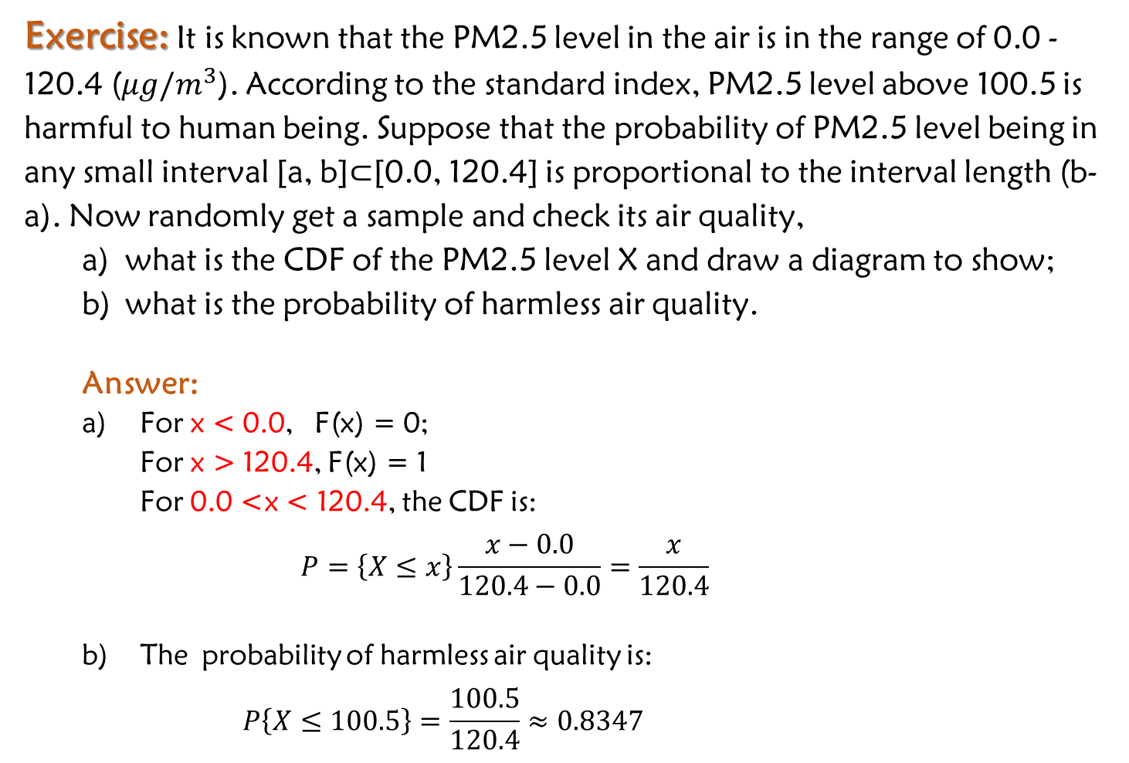
Exercise: It is known that the PM2.5 level in the air is in the range of 0.0 - 120.4 ($μg/m^{3}$). According to the standard index, PM2.5 level above 100.5 is harmful to human being. Suppose that the probability of PM2.5 level being in any small interval [a, b]$⊂$[0.0, 120.4] is proportional to the interval length (b-a). Now randomly get a sample and check its air quality,
what is the CDF of the PM2.5 level X and draw a diagram to show;
what is the probability of harmless air quality.
Answer:
For x < 0.0, F(x) = 0;
For x > 120.4, F(x) = 1
For 0.0 <x < 120.4, the CDF is:
$$P=\left\{X≤x\right\}\frac{x−0.0}{120.4−0.0}=\frac{x}{120.4}$$
The probability of harmless air quality is:
$$P\left\{X≤100.5\right\}=\frac{100.5}{120.4}≈0.8347$$
100.5

Slide 19
Some important distributions of discrete random variable
Single point distribution (单点分布)
Two points distribution (两点分布)
Binomial Distribution (二项分布)
Geometric distribution (几何分布)
Negative binomial distribution (负二项分布)
Hypergeometric Distribution (超几何分布)
Poisson distribution (泊松分布)

Slide 20
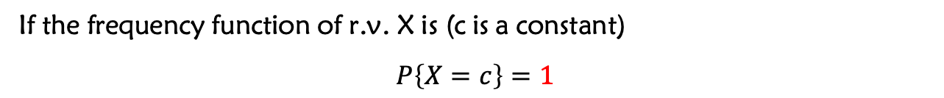
(1) Single point distribution (单点分布)
If the frequency function of r.v. X is (c is a constant)
$$P\left\{X=c\right\}=1$$
Then r.v X is called to follow a Single Point Distribution.
Note:
Single point distribution does not really have “randomness”. However, for theoretical completeness, it is regarded as a random variable.
Single point distribution is also called the degenerate distribution (退化分布).
If the probability of an event is 1, we call the event happens “almost everywhere”.
Example:
$P\left\{X=c\right\}=1 ⟹$ $X\underset{⇒}{a.e}c or X=c (a.e)$
$P\left\{X=y\right\}=1 ⟹$ $X\underset{⇒}{a.e}y or X=y (a.e)$
Notes:
- Y is another random variable

Slide 21
(2) (0-1)Two Point Distribution（两点分布）
— Bernoulli Random variables（伯努利随机变量）
If the Frequency Function of r.v. X is
$$P\left\{X=1\right\}=p, P\left\{X=0\right\}=1−p$$
Then r.v. X is called to follow a (0-1) Two Point Distribution and $0<p<1$ is constant
The background of (0-1) Two Point distribution
If an experiment has only two possible outcomes, it can be described by the r.v. which follows the (0-1) Two point distribution.
Example: The outcome of an exam: “Pass” or “Fail”.
Example: The gender of a newborn baby: “boy” or “girl”
Example: The result of a single shooting: “hit” or “miss”.

Slide 22
(3) Binomial Distribution (二项分布) and Bernoulli Trial (伯努利实验)
Bernoulli Trial: an experiment which has only two possible outcomes.
n-Time Bernoulli Trial (n重伯努利实验): repeating the Bernoulli Trial n times independently. It is also called as a Bernoulli Process.
Question: What random variable does Bernoulli Trial produce?
Example: A solider shoots a target, let
$$A=\left\{hit\right\}, \overline{A}=\{miss\}$$
Every shooting is a Bernoulli Trial. If shooting the target n times, it is a“n-Time Bernoulli Trial” or a Bernoulli Process
Example: Pick a product from a group of products to check its quality, let
$$A=\left\{pass\right\}, \overline{A}=\{fail\}$$
Every pick is a Bernoulli trial.
Question: If n products are picked at the same time for independently quality checking, is this an “n-Time Bernoulli Trial”?
Notes:
why? I don’t understand why the answer for the second question is no.
Because the probability for a picked product to be defective changes every time because the picking process is considered as sampling without replacement?
Yes, it depends on whether it is sample with or without replacement.
Check the term “n-Time Bernoulli Trial” and ”Bernoulli Process”.

Slide 23
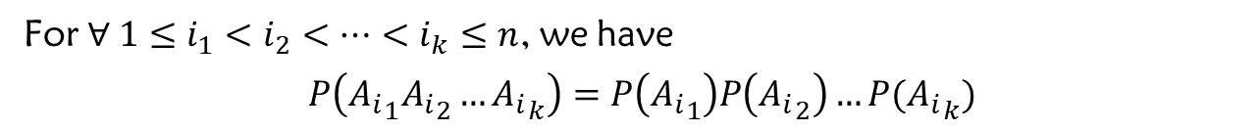
Note
In a Bernoulli Trial, let
$$P\left(A\right)=p, P\left(\overline{A}\right)=1−p$$
“Repeat” means that the probability P(A) = p keeps unchanged in every trial.
“Independent” means that the outcome of every trial does not impact to each other.
Let
$$A_{i}=\left\{ith trial^{′}s outcome\right\}, i=1, 2,…, n$$
For $∀ 1≤i_{1}<i_{2}<…<i_{k}≤n$, we have
$$P\left({A_{i}}_{1}{A_{i}}_{2}…{A_{i}}_{k}\right)=P\left({A_{i}}_{1}\right)P\left({A_{i}}_{2}\right)…P({A_{i}}_{k})$$
Since, every Bernoulli Trial has two outcomes: A and $\overline{A}$
let
$$X=how many times that Event A happened in the Bernoulli Process.$$
Then, X is a discrete r.v.
Question
What is the Frequency Function of X?

Slide 24


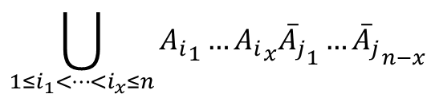





$$X=how many times that event A happened in the Bernoulli process.$$
The possible values of X are
0, 1, 2, …, n
$$\begin{matrix}A happened x times \\ \overline{A} happended (n−x) times\end{matrix}$$
$$\{X=x\}$$
$$n independent trials$$
$$\bigcup_{1≤i_{1}<…<i_{x}≤n}{{A_{i}}_{1}…{A_{i}}_{x}{{\overline{A}}_{j}}_{1}…{{\overline{A}}_{j}}_{n−x}}$$
$$∴P\left\{X=x \right\}=P\left\{\bigcup_{1≤i_{1}<…<i_{x}≤n}{{A_{i}}_{1}…{A_{i}}_{x}{{\overline{A}}_{j}}_{1}…{{\overline{A}}_{j}}_{n−x}}\right\}$$
有限可加性
$$P(\bigcup_{k=1}^{n}{A_{k}}=\sum_{k=1}^{n}{P}(A_{k})$$
$$=\sum_{1≤i_{1}<…<i_{x}≤n}{P\{}{A_{i}}_{1}…{A_{i}}_{x}{{\overline{A}}_{j}}_{1}…{{\overline{A}}_{j}}_{n−x}\}$$
x
n-x
$$=\sum_{1≤i_{1}<…<i_{x}≤n}{p…p\left(1−p\right)…(1−p)}$$
$$=C_{n}^{k}p^{x}{\left(1−p\right)}^{n−x} (x=0, 1, 2,…,n)$$

Slide 25

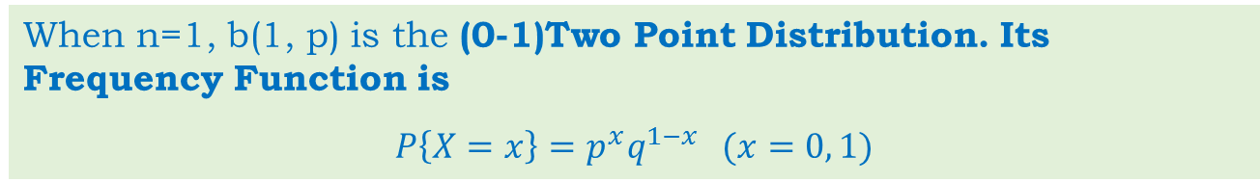
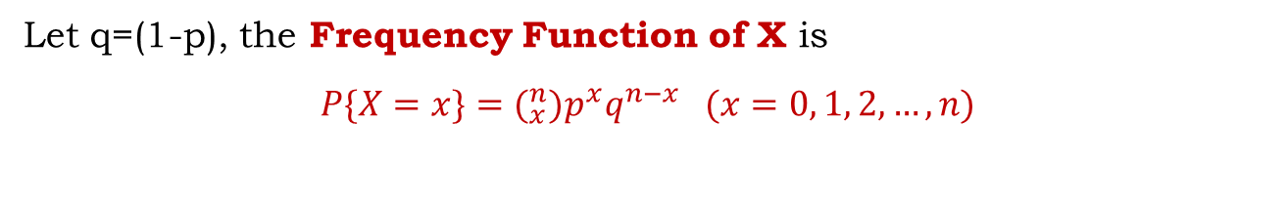

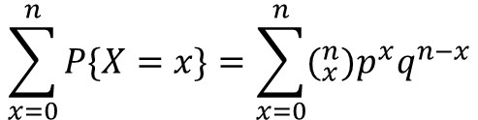

Let q=(1-p), the Frequency Function of X is
$$P\{X=x\}=(_{x}^{n}{)p}^{x}q^{n−x} (x=0, 1, 2,…, n)$$
Thus:
①
$$P\left\{X=x\right\}≥0 (x=0, 1, 2,…,n)$$
②
$$\sum_{x=0}^{n}{P\{X=x\}}=\sum_{x=0}^{n}{(_{x}^{n}{)p}^{x}q^{n−x}}$$
$$={\left(p+q\right)}^{n}=1$$
Definition: If the Frequency Function of r.v. X is
$$P\left\{X=x\right\}=(_{x}^{n}{)p}^{x}{\left(1−p\right)}^{n−x} \left(x=0, 1, 2,…, n\right),$$
then X follows the Binomial Distribution (二项分布) with parameter (n, p), denoted as $X\sim b(n,p)$.
When n=1, b(1, p) is the (0-1)Two Point Distribution. Its Frequency Function is
$$P\left\{X=x\right\}=p^{x}q^{1−x} (x=0, 1)$$

Slide 26

The Frequency Function of the Binomial Distribution
$$P\{X=x\}=(_{x}^{n}{)p}^{x}{\left(1−p\right)}^{n−x}$$
n=10, p=0.1
n=10, p=0.5

Slide 27

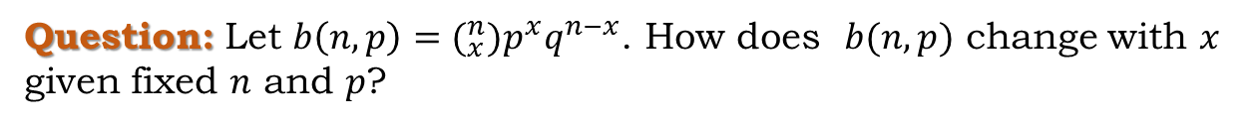
The Frequency Function of the Binomial Distribution
$$P\{X=x\}=(_{x}^{n}{)p}^{x}{\left(1−p\right)}^{n−x}$$
Question: Let $b\left(n,p\right)=(_{x}^{n}{)p}^{x}q^{n−x}$. How does $b(n,p)$ change with $x$ given fixed $n$ and $p$?
Answer: Consider the following:
$$\frac{b(x;n,p)}{b(x−1;n,p)}=\frac{(_{x}^{n}{)p}^{x}q^{n−x}}{(_{x−1}^{n}{)p}^{x−1}q^{n−x+1}}=\frac{\left(n−x+1\right)p}{xq}=1+\frac{\left(n+1\right)p−x}{xq}$$
When x$<\left(n+1\right)p$, $b(x;n,p)$ increases as $x$ increases.
When x$>\left(n+1\right)p$, $b(x;n,p)$ decreases as $x$ increases.
When m$=\left(n+1\right)p$ is an integer, $b\left(m;n,p\right)=b(m−1;n,p)$.
Appears most frequently

Slide 28



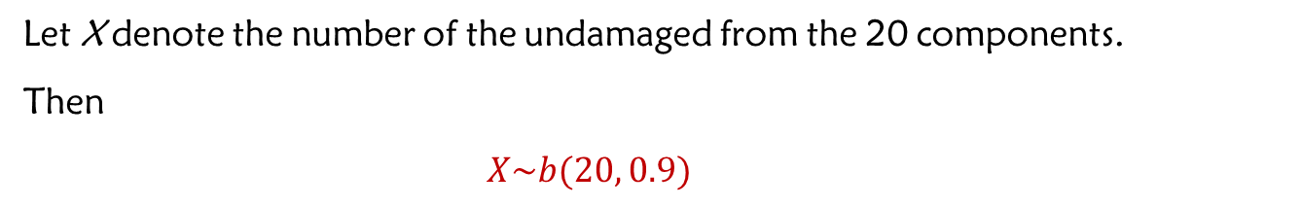

Applications:
The Binomial Distribution comes from an n-time Bernoulli Trial.
Example: 10% components from a huge group of electronic components are damaged. Randomly pick 20 components from the group to build a device, what is the probability that the device can work properly?
Answer: Since the total number of components is huge, the picking process can be considered as sampling with replacement.
Let X denote the number of the undamaged from the 20 components.
Then
$X\sim b(20, 0.9)$
Probability for undamaged components in the group is
90%
$$P\left\{the device works properly\right\}=P\{X=20\}$$
$$=(_{x}^{n}{)p}^{x}{\left(1−p\right)}^{n−x}$$
$$=C_{20}^{20}∗{0.9}^{20}∗{0.1}^{20−20}$$
$$={0.9}^{20}$$
$$≈0.1216$$
Notes:
- As the picking process is considered as sampling with replacement, the probability for a component to be undamaged is the same for every trial.

Slide 29

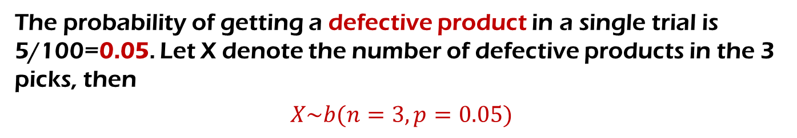
Example: There are 5 defective products among 100 products. 3 products were sampled with replacement by picking one product each time. What is the probability of getting 2 defective products in the 3 picks?
Answer: Since it is sampling with replacement, the 3 trials are in the same context and are independent from each other. This suggests that the trails are Bernoulli Trials with n = 3.
The probability of getting a defective product in a single trial is 5/100=0.05. Let X denote the number of defective products in the 3 picks, then
$$X\sim b(n=3, p=0.05)$$
Thus, the probability is:
$$P\left\{X=2\right\}=(_{2}^{3}{)\left(0.05\right)}^{2}\left(0.95\right)=0.007125$$

Slide 30

Example: There are 5 defective products among 100 products. 3 products were sampled with replacement by picking one product each time. What is the probability of getting 2 defective products in the 3 picks?
Attention:
If we change the condition “sampling with replacement” to “sampling without replacement”, the context for each trail later on has been changed so that the trials are not Bernoulli Trials anymore.
We have to apply Classical Probability (combination) to obtain the result: Here X~Hypergeom(N=100, n=3,k=5)
$$P\left\{X=2\right\}=\frac{(_{1}^{95}{)(}_{2}^{5})}{(_{3}^{100})}≈0.00618$$

Slide 31


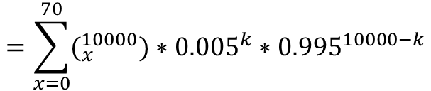






The insurance industry is one of the earliest industries that applied Probability theory for their business. Insurance companies need to calculate the probability of their services so as to evaluate their company's profit.
Example: 10,000 people bought insurance for their car. Assume every person only has one car and has a car accident per year as maximum). In general, the probability of having a car accident is 0.005. (1) What is the probability that 40 people have a car accident in the next year? (2) What is the probability that 70 people have a car accident in a year? (3) What is the probability that maximum 70 people have a car accident in the coming year?
Answer: Let X denote the total number of the car accidents in a year for this case, then
$$X\sim b(10000, 0.005)$$
$$\left(1\right)P\{X=40\}$$
$$=(_{40}^{10000})∗{0.005}^{40}∗{0.995}^{9960}$$
$$≈0.0214$$
$$\left(2\right)P\{X=70\}$$
$$=(_{70}^{10000})∗{0.005}^{70}∗{0.995}^{9930}$$
$$≈0.00134$$
$$=\sum_{x=0}^{70}{(_{x}^{10000})}∗{0.005}^{k}∗{0.995}^{10000−k}$$
$$\left(3\right)P\{X≤70\}$$
$$≈0.997$$

Slide 32
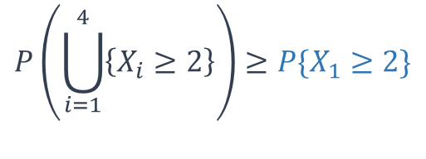
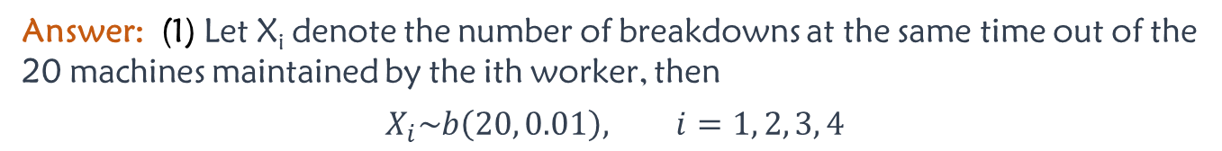


Example: There are 80 same type machines working independently. The probability that a machine breaks down is 0.01. A breakdown can be handled only by one worker. Consider the two ways of allocating maintenance workers:
allocate 4 workers to maintain the machines . Each worker takes care of 20 machines.
Allocate 3 workers to maintain all the machines together.
Compute the probability for the two ways that breakdowns can not be handled in time.
Answer: (1) Let X_{i} denote the number of breakdowns at the same time out of the 20 machines maintained by the ith worker, then
$$X_{i}\sim b\left(20, 0.01\right), i=1, 2, 3, 4$$
The probability that the breakdowns cannot be handled on time is
$$P\left(\bigcup_{i=1}^{4}{\left\{X_{i}≥2\right\}}\right)≥P\{X_{1}≥2\}$$
$$=1−P\left\{X_{1}=0\right\}−P\{X_{1}=1\}$$
$$=1−C_{20}^{0}∗{0.01}^{0}∗{0.99}^{20}−C_{20}^{1}∗{0.01}^{1}∗{0.99}^{19}$$
$$≈0.0169$$

Slide 33
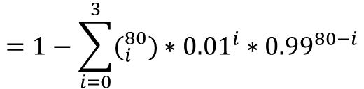
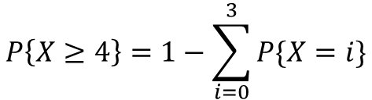

Example: There are 80 same type machines working independently. The probability that a machine breaks down is 0.01. A breakdown can be handled only by one worker. Consider the two ways of allocating maintenance workers:
allocate 4 workers to maintain the machines . Each worker takes care of 20 machines.
Allocate 3 workers to maintain all the machines together.
Compute the probability for the two ways that breakdowns can not be handled in time.
Answer: (2) Let X denote the total number of breakdowns at the same time out of the 80 machines maintained by the 3 workers, then
$$X\sim b\left(n=80, p=0.01\right)$$
The probability that the breakdowns cannot be handled on time is
$$P\left\{X≥4\right\}=1−\sum_{i=0}^{3}{P\{X=i\}}$$
$$=1−\sum_{i=0}^{3}{(_{i}^{80})}∗{0.01}^{i}∗{0.99}^{80−i}$$
$$≈0.0087$$
Based on the results (Way 1 the probability is 0.0169 and Way 2 the probability is 0.0087), we conclude that the working efficiency in Way 2 is higher than Way 1.

Slide 34
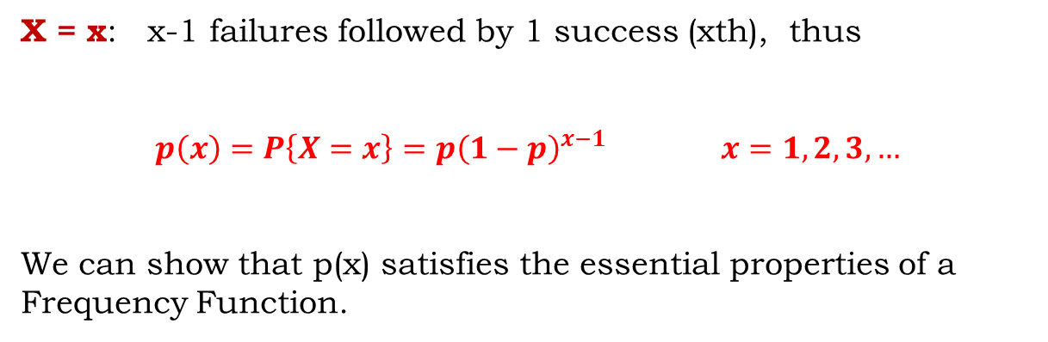
Geometric Distribution and Negative Binomial Distribution
(几何分布和负二项分布)
Geometric distribution is also constructed from independent Bernoulli Trials.
In each trial, a success occurs with probability p.
Let X be the total number of trials until the first success, including the first success.
F F F … … F S
x trials
X = x: x-1 failures followed by 1 success (xth), thus
$$p\left(x\right)=P\left\{X=x\right\}=p{\left(1−p\right)}^{x−1} x=1, 2, 3,…$$
We can show that p(x) satisfies the essential properties of a Frequency Function.
Notes:
Properties of frequency function:
p(k) >=0
Sum of p(k) equals 1
等比数列：geometrical sequence

Slide 35
Example: In some country, the probability of winning a lottery is 1/9.
The total lottery tickets (X) that a winner has purchased until he/she first wins the lottery follows the Geometric Distribution with p=1/9.
The probability mass function of a geometric distribution random variable with p=1/9
0.12
0.1
0.08
p(x)
0.06
0.04
0.02
0
0
10
20
30
40
50
x
$$p\left(x\right)=P\left\{X=x\right\}=p{\left(1−p\right)}^{x−1}$$

Slide 36
Geometric Distribution and Negative Binomial Distribution
(几何分布和负二项分布)
Negative Binomial Distribution is a generalization of the Geometric Distribution.
A sequence of independent trials (each with probability of success p)
is performed until there are r successes in total.
X denotes the total number of trials.
The last one must be a Success
r Successes
F F F … … F S F F F S F F F F … … SF F F F FFS
x trials
From the independence assumption, any particular of such a sequence has probability $p^{r}{\left(1−p\right)}^{x−r}$
The last trial must be Success, and the remaining (r-1) successes are from the remaining (x-1) trials. Therefore:
$$p\left(x\right)=P\left\{X=x\right\}=(_{r−1}^{x−1}{) p}^{r}{\left(1−p\right)}^{x−r}, x=1,2,3,…$$
The Negative Binomial Distribution when r=1 is the Geometric Distribution.

Slide 37
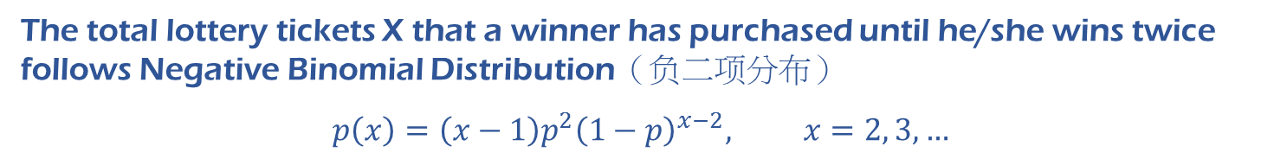
Example: In some country, the probability of winning a lottery is 1/9.
$$p\left(x\right)=P\left\{X=x\right\}=(_{r−1}^{x−1}{) p}^{r}{\left(1−p\right)}^{x−r}, x=r, r+1,r+2,r+3,…$$
The total lottery tickets X that a winner has purchased until he/she wins twice follows Negative Binomial Distribution（负二项分布）
$$p\left(x\right)=\left(x−1\right)p^{2}{\left(1−p\right)}^{x−2}, x=2, 3,…$$
r = 2
The probability mass function of a negative binomial random variable with p=1/9 and r = 2
0.045
0.04
0.035
0.03
p(x)
0.025
0.02
0.015
0.01
0.005
0
0
10
20
30
40
50
x

Slide 38

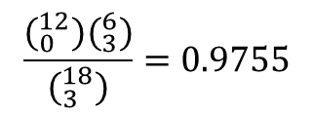
Hypergeometric Distributions (超几何分布)
Suppose that a box contains N balls, of which r are black and N-r are white.
Take n balls from the box without replacement.
Let X denote the number of black balls drawn.
$$P\left\{X=x\right\}=\frac{(_{x}^{r}) (_{n−r}^{N−r})}{(_{n}^{N})}, x=1,…,n$$
Then X follows Hypergeometric Distribution with parameters r, N, and n.
X~Hyper(N,n,r)
Example: Suppose that among 18 major IT companies in the US, there are 12 located in the Silicon Valley. Now randomly pick 3 out of the 18 companies, what is the probability that at least one is in the Silicon Valley?
Answer: Let X denote the number of companies out of the 3 picked ones that are in the Silicon Valley.
Then X~Hyper(N=18, n=3, r=12)
$$\frac{(_{0}^{12}{)(}_{3}^{6})}{(_{3}^{18})}=0.9755$$
$$P\left\{X≥1\right\}=1−P\left\{X<1\right\}=1−P\left(X=0\right)=1−$$

Slide 39
Poisson Distribution（泊松分布）
Poisson distribution is a discrete distribution that measures the probability of a given number of events happening in a specified time period.
Example: Random service system: customer calling help center
Example: The occurrence of sparseness: people visiting a website .
Example: Phenomena in physics: radioactive decay in atoms .
…
It arises in connection with Poisson process.
Notes:
- Radioactive decay: 放射性衰变; acre: 英亩

Slide 40
Poisson Distribution
Poisson distribution is a discrete distribution that measures the probability of a given number of events happening in a specified time period.
Poisson Process (泊松过程): a model for a sequence of discrete events where the average time between events happening is known, but the exact time between two events is random. It refers to that random events appears continuously over the timeline as time goes by.
A Poisson Process meets the following two criteria:
Events are independent to each other, i.e., the occurrence of an event does not affect the probability of another event will occur.
The average rate $λ$ (events per unit time period) is a constant and known .
Question: In a Poisson Process, let X denote the number of the events occurring within a specific period of time, what distribution does X follow?
Notes:
- Radioactive decay: 放射性衰变; acre: 英亩

Slide 41
Poisson Distribution
Poisson distribution is a discrete distribution that measures the probability of a given number of events happening in a specified time period.
Poisson Process (泊松过程): a model for a sequence of discrete events where the average time between events happening is known, but the exact time between two events is random. It refers to that random events appears continuously over the timeline as time goes by.
A Poisson Process meets the following two criteria:
Events are independent to each other, i.e., the occurrence of an event does not affect the probability of another event will occur.
The average rate $λ$ (events per unit time period) is a constant and known .
For example: An estate agent sells houses on average 2 houses per day. The data shows :
Day 1: 2 houses
Day 2: 0 house
Day 3: 4 house
Day 4: 2 house
Day 5: 1 houses
…
The number of houses sold follows Poisson Distribution over the timeline - days.
Question: what is the probability of selling 3 houses in a day?
Notes:
- Radioactive decay: 放射性衰变; acre: 英亩

Slide 42
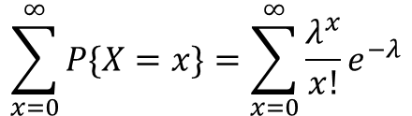
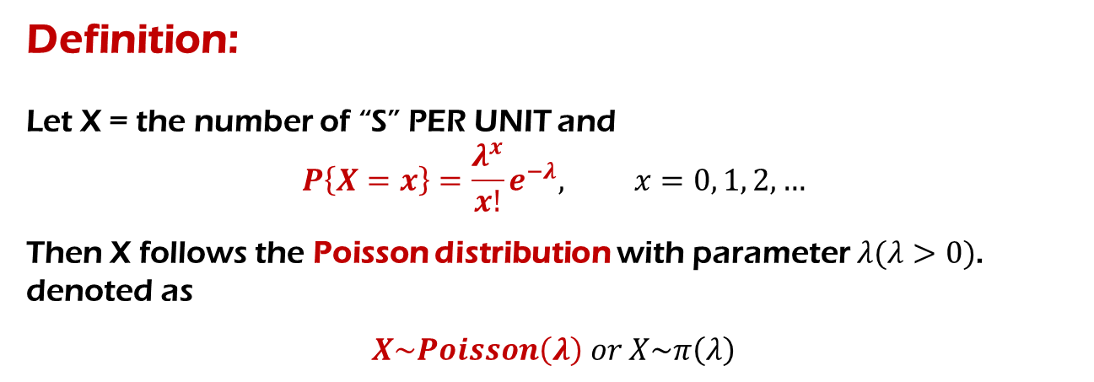

Definition:
Let X = the number of “S” PER UNIT and
$$P\left\{X=x\right\}=\frac{λ^{x}}{x!}e^{−λ}, x=0, 1, 2,…$$
Then X follows the Poisson distribution with parameter $λ(λ>0)$. denoted as
$$X\sim Poisson\left(λ\right) or X\sim π\left(λ\right)$$
The properties of the Poisson Distribution:
$$P\left\{X=x\right\}>0, x=0, 1, 2,…$$
$$\sum_{x=0}^{∞}{P\{X=x\}}=\sum_{x=0}^{∞}{\frac{λ^{x}}{x!}e^{−λ}}$$
$$=e^{λ}∙e^{−λ}=1$$
Note
The Poisson distribution is popular for modeling the number of the events occurring in an interval of time or space.
Notes:
- By Taylor expansion, $e^{λ}$=$\sum_{k=0}^{∞}{\frac{λ^{k}}{k!}}$

Slide 43
λ
Poisson Frequency Functions with different
λ= 0.1
λ= 5
1
0.2
0.9
0.8
0.15
0.7
0.6
p (x)
0.1
p (x)
0.5
0.4
0.3
0.05
0.2
0.1
0
0
0
1
2
3
4
5
-5
0
5
10
15
20
25
x
λ= 1
x
λ= 10
0.4
0.2
0.35
0.3
0.15
0.25
p (x)
p (x)
0.2
0.1
0.15
0.1
0.05
0.05
0
0
0
1
2
x
3
4
5
-5
0
5
10
15
20
25
x

Slide 44
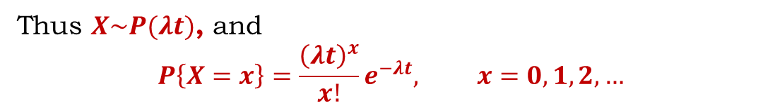
The relation between Poisson Distribution and Poisson Process
In a Poisson Process, let X denote the number of the events occurring within a time interval (0,t]
Timeline
0
t
Thus $X\sim P(λt)$, and
$$P\left\{X=x\right\}=\frac{{\left(λt\right)}^{x}}{x!}e^{−λt}, x=0,1,2,…$$
The parameter $λ>0$ is called the Poisson Intensity (泊松强度).

Slide 45
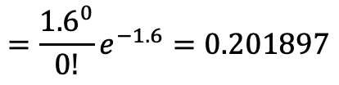

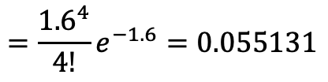
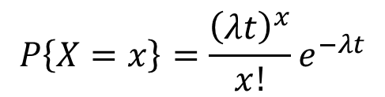




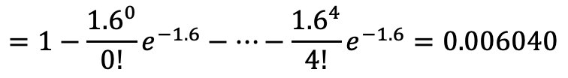
Example:
An estate agent sells 1.6 houses per day on average , and the number of houses sold follows Poisson Distribution.
What is the probability of selling 4 houses in a day?
What is the probability of selling no house in a day?
What is the probability of selling at least 5 houses in a day?
What is the probability of selling 4 houses in two days?
$$P\left\{X=x\right\}=\frac{{\left(λt\right)}^{x}}{x!}e^{−λt}$$
$$=\frac{{1.6}^{4}}{4!}e^{−1.6}=0.055131$$
$$P\{X=4|λt=1.6\}$$
$$=\frac{{1.6}^{0}}{0!}e^{−1.6}=0.201897$$
$$P\{X=0|λt=1.6\}$$
$$=1−\frac{{1.6}^{0}}{0!}e^{−1.6}−…−\frac{{1.6}^{4}}{4!}e^{−1.6}=0.006040$$
$$P\{X≥5|λt=1.6\}$$
$$=\frac{{3.2}^{4}}{4!}e^{− 3.2}=0.178093$$
$$P\left\{X=4 | λt=3.2\right\}$$

Slide 46

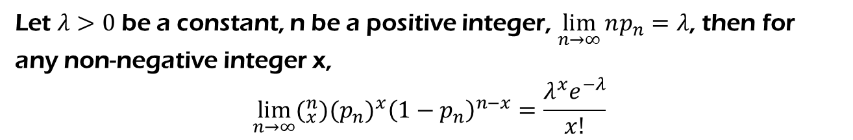
Poisson Theorem (泊松定理)
Let $λ>0$ be a constant, n be a positive integer, $\lim_{n→∞}{np_{n}}=λ$, then for any non-negative integer x,
$$\lim_{n→∞}{(_{x}^{n}{)(p}_{n}^{}{)_{}^{x}\left(1−p_{n}\right)}^{n−x}}=\frac{λ^{x}e^{−λ}}{x!}$$
Thus
$${ (}_{x}^{n}{)p}^{x}{\left(1−p\right)}^{n−x}≈\frac{λ^{x}e^{−λ}}{x!}$$
Binomial Distribution
(When n is very large, p is very small)
Poisson Distribution
When n is very large and p is very small, the Frequency Function of Poisson distribution can be used to approximate the Frequency Function of Binomial distribution.

Slide 47
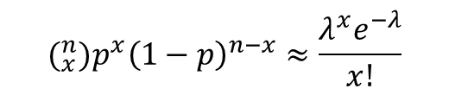


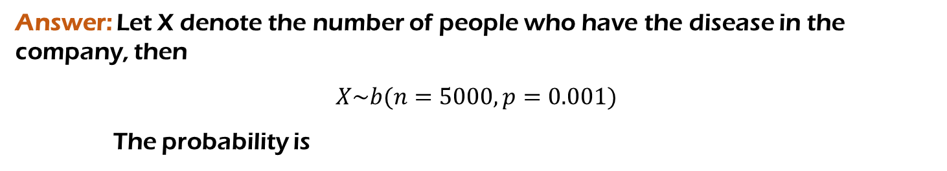
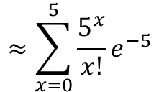

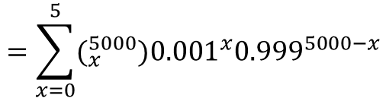

Example: Assume the occurrence of a disease is 0.001. A company has 5000 people. What is the probability that at most 5 people have the disease in the company?
Answer: Let X denote the number of people who have the disease in the company, then
$$X\sim b(n=5000, p=0.001)$$
The probability is
It is very difficult to calculate, though we can use Excel to get the result …
$$=\sum_{x=0}^{5}{(_{x}^{5000}{)0.001}^{x}{0.999}^{5000−x}}$$
$$P\left\{X≤5\right\}$$
Because the n is very large and p is very small, the Poisson Theorem should be applied.
$$(_{x}^{n}{)p}^{x}{\left(1−p\right)}^{n−x}≈\frac{λ^{x}e^{−λ}}{x!}$$
Let $λ=np=5,$ we have
$$≈\sum_{x=0}^{5}{\frac{5^{x}}{x!}e^{−5}}$$
$$P\left\{X≤5\right\}$$
$$=0.616$$

Slide 48
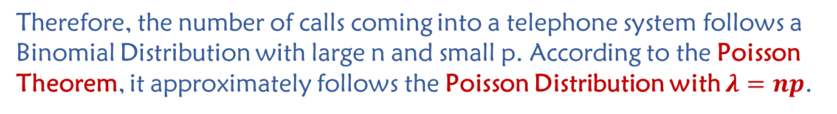
In real life, there are many applications of Poisson Distribution. For example, the number of calls coming into a telephone system; the number of rare events in a period of time(accident, disaster), etc.
All the examples above are actually Binomial Distributions with large n and small p. e.g., the user number n of a telephone system is large, while the probability p that each user uses the service at a certain time is low, and users are independent to each other.
Therefore, the number of calls coming into a telephone system follows a Binomial Distribution with large n and small p. According to the Poisson Theorem, it approximately follows the Poisson Distribution with $λ=np$.
The Poisson Distribution has been widely used in many aspects of real life. It played a significant role in operational research and management science.

Slide 49

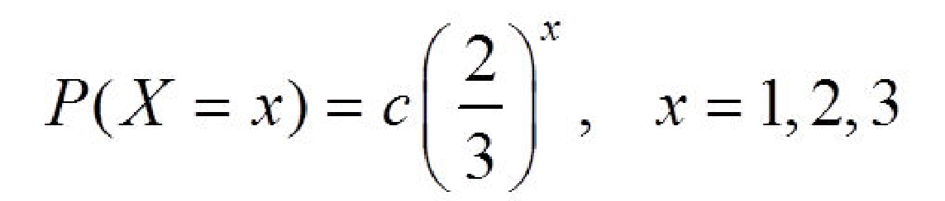
Homework
P64: 1,15,31
Supplementary Questions
1. Assume that the frequency function of random variable X is
find the value of the coefficient c.
2. Suppose a random variable X follows the Poisson distribution. Find the value of k such that P(X = k) reaches its maximum?
Notes:
- Homework for March 9th lecture: P46, 31 + Supplementary Questions 2, 3, 4

Slide 50

3. Assume that there are 2 defective products out of 15. Select one product each time for 3 times without replacement and let $X$ denote the number of defective products.
Compute the frequency function of $X$；
Find the distribution function of $X$ and draw its graph；
Compute:
$P\{X≤\frac{1}{2}\},P\{1<X≤\frac{3}{2}\},P\{1≤X≤\frac{3}{2}\},P\{1<X<2\}$.
4. There are 2500 people of the same age and class level who bought the same life insurance from a company. The chance of each person dying within a year is 0.002. The premium is 12 RMB each year and their family will receive a settlement of 2000 RMB upon the death of an insurant. Compute
The probability that the insurance company has deficit;
The probability of the insurance company to gain a profit of at least 10000? 20000?

Slide 51
Thank
You

